Slide 1
November 15, 2023
Subscription video-on-demand (SVOD) industry
Group 7
Francisco Arrieta, Weihui Dong, Manuela Giansante, Alina Poliakova, Raiyan Puntel, & Emily Schmidt
Notes:
Manuela to introduce the industry of SVOD (Digital media – industry , video streaming is the segment )
The model allows the user to have access to a vast catalogue of video content in exchange of a fixed amount, usually paid monthly.

Slide 2
Porter’s five forces: svod
Section 1
HIGH
MODERATE
LOW
Notes:
We conducted

Slide 3
Bargaining power of buyers
MODERATE
High concentration of competitors within the SVOD market.
Threat of backward integration due to the financial, technical, and additional resources that are required. (1)
Customers are dependent on providers for specific content that are only hosted on their platform. (2)
Low switching cost between producers since the SVOD corporations are price conscious. (3)
Numerous producers who have platforms that contain a vast variety and quantity to offer the market.
Buyer is price sensitive and they have the advantage of no additional cost for cancellation or membership. (4)
Notes:
Came to the conclusion/estimated
Starting from the ones with a negative impact on the users' power
(-) few options to choose from also relative the low concetration of the users – users do not have the ability to influence prices nor the offered content,
The next two are connected :
Threat of backwards integration as these compnies wil become more and more independent in their content production
(+) low switching costs, variety of choice, buyer is price sensitive
The vast offer incentivizes weak brand loyalty

Slide 4
Bargaining power of suppliers
HIGH
Creating original content is crucial for these platforms to establish more market power over suppliers. (5)
Threat of forward integration exists as players have taken action to create their own streaming platform to screen their own films and series, a direct-to-consumer business model.
Suppliers often have a strong position in negotiations due to the popularity and demand for their content.
High switching costs driven by long-term commitments, contract negotiations, or customized platforms with unique specifications which all rely on reliable resources. (6)
Notes:
Evaluated
All the players that supply either the media content or the hardware/software needed
When we look at content providers we see that forward integration many adopted a direct to customer models
And even thse who did not they still play an important role in teh negotiations – especially if the piece of media in very sought after
For what reards the more logstics side of thing
(-) as mentioned before – the independence in production of content is crucial
(+) threat of forward integration from competitors (disney) –
Suppliers of content -> afore mentioned point on independent content production

Slide 5
Threat of substitutions
LOW
An alternative product is more expensive than the market product. (7)
Generic substitution: Live events and sports, radio and music streaming, video gaming, etc. Physical entertainment industry has been continuously declining, partially accelerated by the pandemic.
Abandoning: Millions of subscribers are canceling their memberships, but the streaming industry is optimistic that the average number of subscriptions per person will rise. (8)
Indirect substitutes are physical branches like TV shows, cinema, DVDs, or other online platforms.
The number of existing platforms continue to grow as more players enter the market.
Notes:
concluded
(-) the threat is multifaced.....
Generic substitution does not necessarily play a heavyweight role ...especially in a post covid society
What we thought was worthy of mention but not necessarily a deciding fact is indirect subsitutes such as....
Yet we must consider that the number of platforms continue to grow, increasing competition within the market

Slide 6
Threat of new entrants
MODERATE
Financial barriers:
Economies of scale create barriers of entry due to high fixed costs, content acquisition.
Initial cost of investment is high. (9)
Barriers based on resources and capabilities:
Power to immediately launch the service with their own content due to substantial resources.
Streaming industry has seen an influx of new players in recent years(10)
Strong dependence on content:
Rise of vertical integration has led to the entry of content owners launching their own streaming platforms. (10)
Low barrier in technology:
A video streaming website is not difficult to set up. (11)
The availability of digital content and advancements in streaming technology. (10)
Notes:
There are two significant types of factors that can lower the threat:
1.The first and also the most important factor is the Financial barriers: In SVOD industry, acquiring, creating, and licensing content can involve a huge amount of financial support.
2. Other factors include Barriers based on resources and capabilities. The established companies can get the power to immediately launch the service with their own content. (E.g. Disney +, who has the franchise of <Star Wars> serial movies , can produce new movies based on that easily.)
On the other side, Streaming industry has seen an influx of new players in recent years. two reasons are listed which increase the threat:
1.Firstly, Strong dependence on content. we can see a rise of vertical integration in the entertainment industry has led to the entry of content owners launching their own streaming platforms.
2.Secondly, Technology barrier is not that high:
1).A video streaming website is not difficult to set up
2).(Barriers to entry in the streaming market are relatively low, primarily due to the availability of digital content and advancements in streaming technology)

Slide 7
COMPETITIVE RIVALRY
RELATIVELY HIGH
High degree of differentiation. (12)
Equilibrium of forces exists due to the competitive and dynamic landscape.
High fixed cost have been invested in creation of new content, licenses, and marketing/advertising (12)
The market growth rate is getting lower.
Brand loyalty is weak in general. (12)
Numerous big players in the Swiss SVOD market remove their most popular shows to their own network. (12)
Notes:
Here, COMPETITIVE RIVALRY is estimated relatively high.
First of all, indeed we can see high degree of differentiation in the industry. E.g. Netflix, Disney+, Amazon all have differentiated content compared to others.
However, the COMPETITIVE RIVALRY is still relatively high, which is based on several factors:
1. Firstly, The equilibrium of forces exists due to the competitive and dynamic landscape:
2. Secondly, High fixed costs have been spent due to creation of new content, licenses, and marketing/advertising .
3. finally, although SVOD industry was experiencing a high growth rate , this rate is decreased recently.

Slide 8
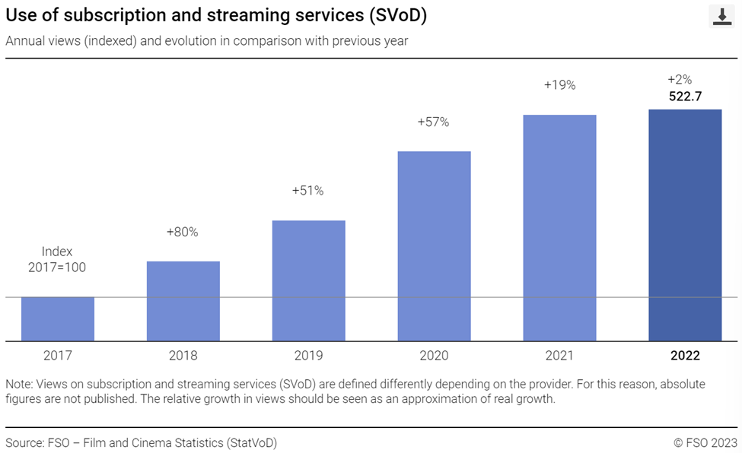
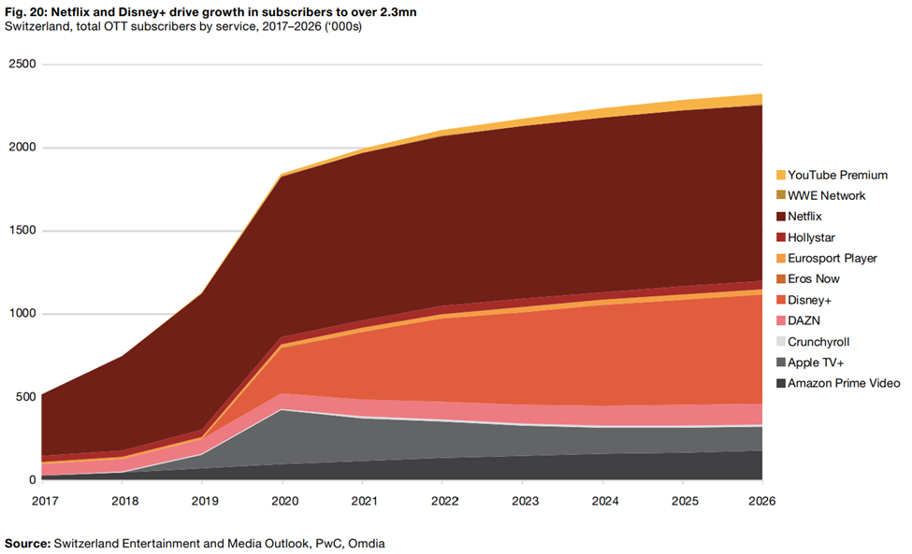
COMPETITIVE RIVALRY
RELATIVELY HIGH
(13)
Notes:
1.we can see In the left figure, from 2017-2020, the average increasing Rate is above 50%. However, in resent two years, it is reduced to 2%, which can increase the intensity of competition.
2.the right figure shows the market share of SVOD industry in Switzerland. Big international player in the market, like netflix and Disney +, take the greatest market shares.

Slide 9
SVOD Industry Analysis Summary
Moderate
Threat of New Entrants
2 strongly rated powers, 2 moderate powers, and 1 low rated power
This industry is still attractive, and provides opportunities for start-ups
High
Moderate
Rivalry Among Existing Competitors
Bargaining Power of Suppliers
Bargaining Power of Suppliers
Relatively High
Threat of New Entrants
Low
Notes:
in all 5 forces, we have 2 strongly rated powers, 2 moderate powers, and 1 low rated power.
So we suppose This industry is still attractive, and provides opportunities for start-ups. We are interested in it and we have also finished firm analysis and competitive strategy analysis.

Slide 10
Core Competencies
Section 2

Slide 11

Competitive Advantages
Expansive Content Library and Franchise Intellectual Properties
Low Cost to Establish Library Content
High Efficiency and Quality in Movie Production
Global Reputation for All-Age Customers, Especially Children
Higher Brand Attachment
Price Competitive Subscription Scheme
In-house Movie Production Capabilities
Brand Legacy
High Quality and Unique Content
Core Competencies

Slide 12
Competitive Advantages
Expansive Content Library and Franchise Intellectual Properties
Low Cost to Establish Library Content
High Efficiency and Quality in Movie Production
Global Reputation for All-Age Customers, Especially Children
Higher Brand Attachment
Price Competitive Subscription Scheme
In-house Movie Production Capabilities
Brand Legacy
High Quality and Unique Content
Core Competencies
Notes:
Disney+ isn't just a streaming service; it is an integral part of your favourite movies, shows, and even theme parks with audience spans across generations. Fun fact for you to know that it gained 10 million subscribers within the first 24 hours after launching.
Core competences:
In-House Movie Production Capabilities: By having in-house movie production capabilities, Disney+ retains greater control over the entire content creation process. This leads to increased efficiency, lower content production costs, and exclusive content creation.
Brand Legacy: Disney's brand legacy is synonymous with trust, quality, and wholesome family entertainment.

Slide 13

Competitive Advantages
Cost-Effective Service Promotion and Cinema Partnerships
Loyal and Quality-Oriented Customer Base
Resource Optimization via Technological Applications
Competitive Pricing through Film Bundles
Expedited Film Delivery and Sustainable Income via TVOD Model
Provides Seamless Integration of Streaming and Cinematic Experience
Efficient, Resource-Optimized Team Minimizes Overhead Costs
Selective and Curated Content
Social Outreach
Localized Relationship Sourcing
Core Competencies
Notes:
Cinefine was founded in 2018 as a trilingual Swiss cinema guide, streaming service and Blu-Ray rental for lovers of international arthouse and entertainment films.
Social Outreach: They cover the world of Swiss cinema. This is fundamentally different than Disney+ because they include information from multiplexes to art house cinemas and open-air festivals, which then is shown on their platform which provides a wide range of content summaries, trailers, ratings, and short reviews.
Selective and Curated Content: Their five-person team targets specific films that align with their ideologies. Cinefile’s selective content behavior is driven by how oversupply on all fronts leads to disorientation, causing useless spending and wasted time on second- and third-rate movies.
Localized Relationship Sourcing: Out of their 700 films, they have managed to supply their customers with 200 Swiss movies. This demonstrates how Cinefile targets small and independent local producers in which they have strong relationships. As their website mentioned, they obtain streaming content from independent and small producers who do not make the cut by the big players.
CEO Incorporates Direct Customer Feedback
Minimizes Customer Search Time for Lower-Quality Films
Established Reputation
Diverse Genre and Quality Associations
Data Ownership for Targeted Film Promotion

Slide 14
Competitive Advantages
Cost-Effective Service Promotion and Cinema Partnerships
Loyal and Quality-Oriented Customer Base
Resource Optimization via Technological Applications
Competitive Pricing through Film Bundles
Expedited Film Delivery and Sustainable Income via TVOD Model
Provides Seamless Integration of Streaming and Cinematic Experience
Efficient, Resource-Optimized Team Minimizes Overhead Costs
Selective and Curated Content
Social Outreach
Localized Relationship Sourcing
Core Competencies
Notes:
Cinefine was founded in 2018 as a trilingual Swiss cinema guide, streaming service and Blu-Ray rental for lovers of international arthouse and entertainment films.
Social Outreach: They cover the world of Swiss cinema. This is fundamentally different than Disney+ because they include information from multiplexes to art house cinemas and open-air festivals, which then is shown on their platform which provides a wide range of content summaries, trailers, ratings, and short reviews.
Selective and Curated Content: Their five-person team targets specific films that align with their ideologies. Cinefile’s selective content behavior is driven by how oversupply on all fronts leads to disorientation, causing useless spending and wasted time on second- and third-rate movies.
Localized Relationship Sourcing: Out of their 700 films, they have managed to supply their customers with 200 Swiss movies. This demonstrates how Cinefile targets small and independent local producers in which they have strong relationships. As their website mentioned, they obtain streaming content from independent and small producers who do not make the cut by the big players.
CEO Incorporates Direct Customer Feedback
Minimizes Customer Search Time for Lower-Quality Films
Established Reputation
Diverse Genre and Quality Associations
Data Ownership for Targeted Film Promotion

Slide 15
Value attributes
Section 3
Notes:
Thank you Emily in addition to the previous sections we will also do a Value attributes analysis to see which aspects of streaming do consumers value the most and then propose a new entry company to this sector

Slide 16
STRATEGY CANVAS
INDUSTRY LEADERS
High
Low
Low Price | Content | Speed of Availability | Device / Application | Original Language | Ease of Use | Content Information & Attributes
Notes:
From our analysis of the various attributes we have identified the following:
Low price
Content
Speed of availability which refers to how fast movies or series are available in a medium or platform to be distributed to consumers
With Device/application we refer to where the platform can be accessed, such as websites, mobile phone apps or smart TVs
Original language is regarding the various translation of content in multiple languages
Ease of use is with regards to the interface and the navigation within the app or website
and content information & attributes is information such as ratings or critiques by movie enthusiasts or reviews and comments by other consumers as well as data about the film’s genre and or actors
As we can see the industry leaders are rather high in many of these aspects with exception to speed of availability as we know from our conversation with Cinefile CEO that streaming platforms are usually last to receive rights to transmit and ease of use can be improved in many applications as it is not so easy to navigate

Slide 17
Mom ntum
Notes:
Having said the previous, our proposal for a new competitor in the SVOD market is Momentum a streaming platform specializing in enabling interactivity of its users within the app as well as promoting more usage through rewards

Slide 18
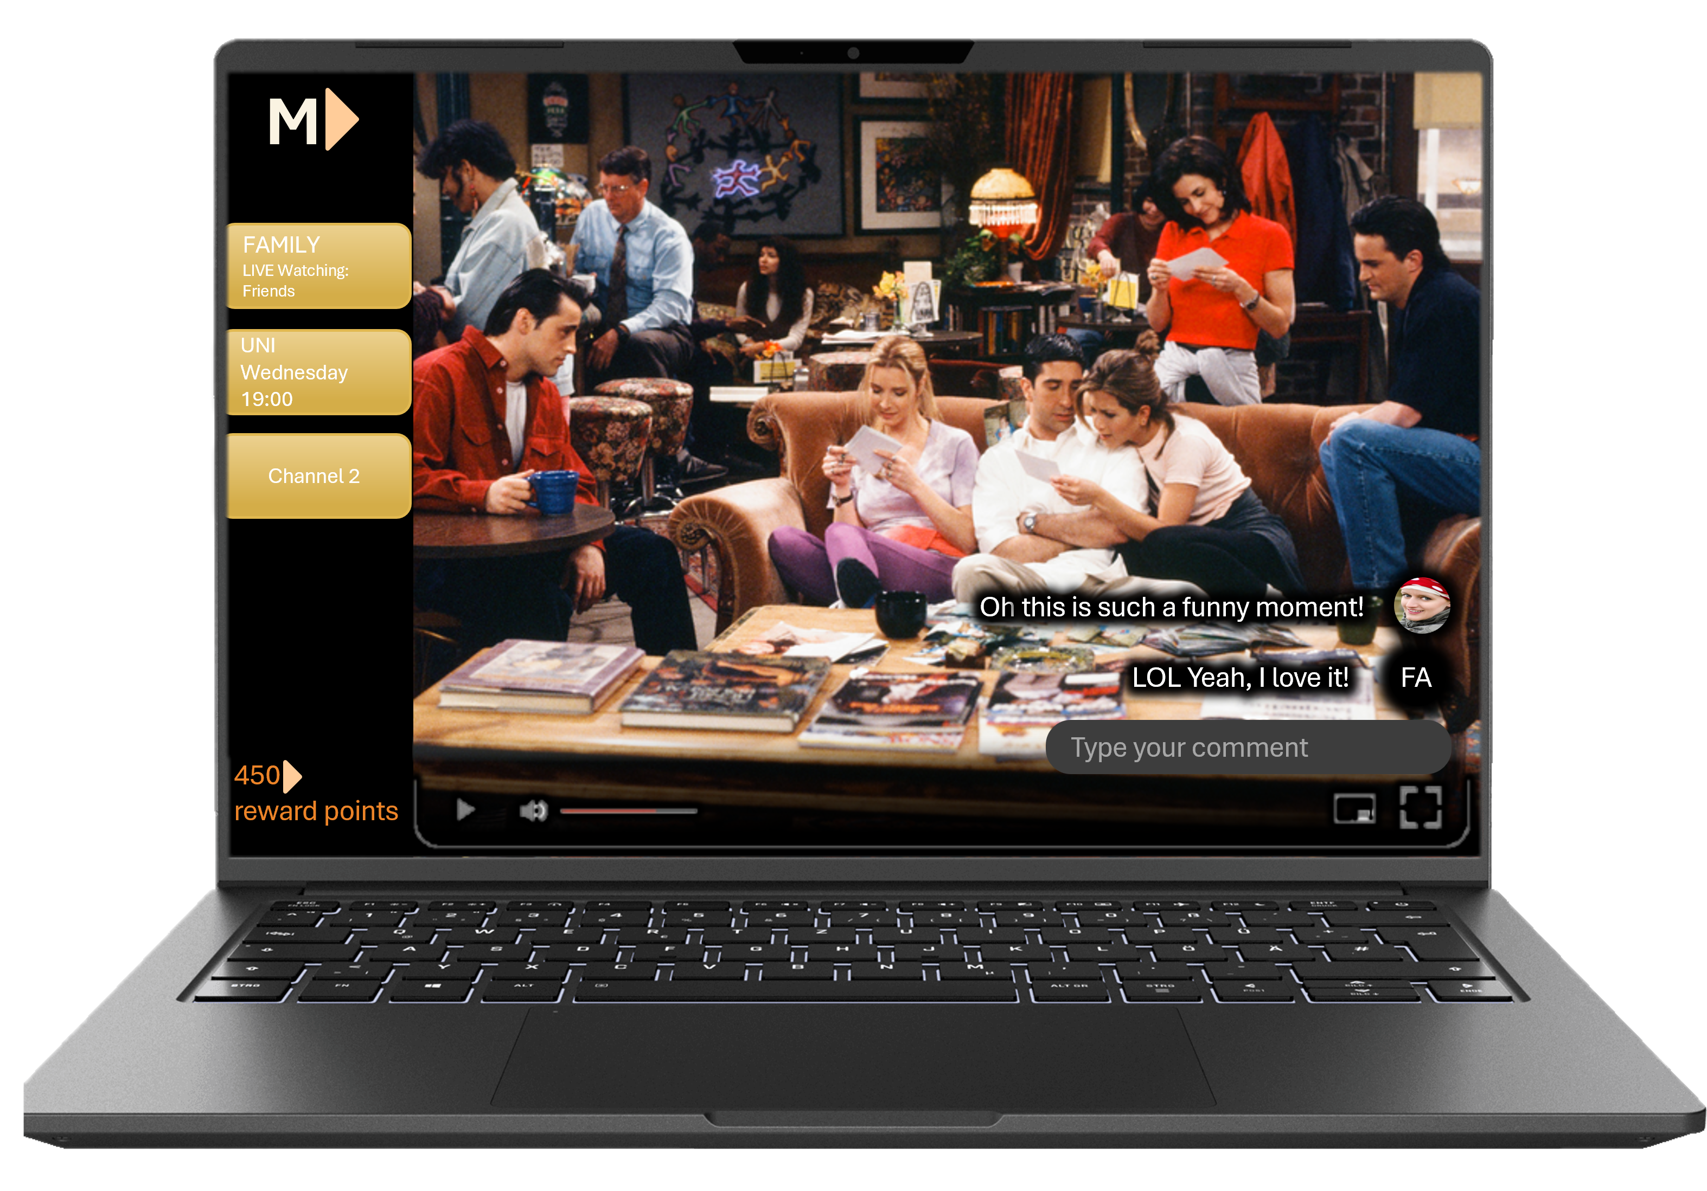
Mom ntum
Description
Streaming service for all TV series with integrated live comments from various sources related to the content and allows for real time watch parties in personal channels. In addition, a rewards program that motivates users to watch more content on the platform.
Strategic Advantage
Leveraging technology to introduce new value attributes:
Interactivity to connect users through our platform
Rewards to increase user engagement
Notes:
So how do we enable interactivity? The service will consist of a similar streaming platform as the major competitors with the added value that you can comment during the streaming of the show allowing for communication in real time to talk about others about the show you are watching.
Various channels can be created with different people to see a particular show, they can be a regular scheduled cadence to see a new TV series or a one off event on a weekend.
Additionally we will enable people to share these comments with anyone so public figures, influencers or movie critics can share their thoughts about what they’re watching.
We will reward points for time watched and incentivize large gatherings so people can really benefit from using our platform.
Company Description
Momentum redefines SVOD standards by seamlessly blending innovation and technology, offering a unique synergy that captivates users in an immersive live entertainment environment. Our platform stands out by fostering interactivity and giving back through a rewards program, promising an engaging and rewarding entertainment experience that goes beyond expectations.
Strategic Advantage
Momentum's strategic advantage lies in leveraging technology to introduce new value attributes. We prioritize interactivity, connecting users through our platform, and incentivize engagement with a rewards program, setting new standards in the streaming service market.

Slide 19
Mom ntum
Target Market
Tech-savvy individuals passionate about TV series and real-time interaction form our target market. Momentum caters to those seeking a cutting-edge, engaging entertainment experience where technology enhances storytelling.
Business Model
Operating on a quarterly renewal TVOD model, Momentum provides users flexibility in accessing our extensive TV series library without the constraints of long-term commitments, ensuring an adaptable and user-centric approach.
Notes:
Our target market will be digitally engaged tech savvy customers with interest in watching content with friends. However, there is no need to always be in groups, as you can also watch on your own.
As a getting people together at the same time can also become complicated, our go-to-market strategy involves offering quarterly TVOD model where you pay the right to watch a certain show and have up to 3 months to watch it with others.
With this we can now compare to the value attributes of the industry for which I will pass it on to Ryan.

Slide 20
STRATEGY CANVAS
INDUSTRY LEADERS
MOMENTUM
High
CREATE
ELIMINATE
Low
REDUCE
RAISE
Low Price | Content | Speed of Availability | Device / Application | Original Language | Ease of Use | Content Information & Attributes | Rewards Program | Interactivity
Notes:
To compete I the SVod market and to be a sustainable company over time as mention earlier we decide to differentiate ourselves.
The first attribute is price we have no choice as a new entrant to have higher price than the big players. we can’t compete with the big players and their « unlimited ressources »
At the end our higher price will result in a lower value for the customer
We also have to reduce the content, we cannot have the same amount of content as big players , we need to concentrate only Tv series because we don’t have enough resources to have Movies also. This goes in hand with the speed of availability. Big companies pay perineum price to get privileged access before anyone else. We can’t afford that so we must reduce this 2 attributes and have lower value form the customer
We also reduce the device on which we can see the Momentum. We believe that we do not need it on all the device. Since our Startegy is different we find it important only to put it on computer, it is easier to type and interact in live.
TV or smartphone are not adapted to have interaction keeping the same quality or ease of use.
We must eliminate also the languages, we find in not important to have many languages since we want one common language for people to interact together. This could help people also to interact on famous quotes.
We want to increase Momentum attributes compared to big player on certains aspect that are not too much ressources demanding. Since our budget is more limited
we can improve on the ease of use. Doing it on only one device make it us easy to improve it. We do not need to to adapt it to different device and we can make it easier to use.
Also
Like Cine file did we want to concentrate on giving more information about the TV series and more ratings. We want something more elaborate and informative for our users .
This 2 will result in higher customer value compared to the big players
At the end what differentiate ourselves on aspect that no one have
First of all as mentioned before we want to do a reward program to us best subscribers. The more you watch the more you are rewarded. We have the phylospy to give back to people who gives us the most.
The second point is the interactive part. We know it is something new we want to bring.
we want our different subscribers to be able to communicate while watching the series on our platform. It will be like watching a series together even if they are physically not together.

Slide 21
Thank you
for your attention

Slide 22
Appendix

Slide 23
Additional five forces comments
Threat of New Entrants
High difficulty in acquiring licenses for streaming media (link)
Challenging to attract enough subscribers to break-even (link)
The need to constantly create new quality content remain in the market (link)
If they can find a technology-based unique selling proposition (UPS), they can use these innovative ideas/features to challenge the established market players. (link)
Barriers to entry and expansion in the retail supply of SVOD services via OTT distribution are low, due to (i) much fewer capacity constraints and (ii) global geographic reach (link)
Competitive Rivalry
Fueled by the continuous need to differentiate through exclusive content offerings as well as the global expansion to capture international markets (link)
Majority of the larger players in the SVOD industry have global clients (link)
Bargaining Power of Buyers
Specifically, within Switzerland only around 40% of the population have SVOD (link)
Certain companies within the industry have decided to crackdown on password sharing, which in some cases has proved to increase new subscriber sign-ups (link)
Bargaining Power of Suppliers
Bargaining power of suppliers is evident in their ability to dictate licensing terms, pricing, and availability of their content. They can demand higher licensing fees, restrict access to certain titles or seasons, and negotiate exclusivity deals with competing streaming platforms (link)
Threat of Substitutes
The level of threat of substitutes is influenced by factors such as content availability, exclusivity, and pricing. If competing streaming platforms or cable/satellite TV services offer a compelling lineup of content, including popular shows, movies, and live events, they can entice subscribers away. Examples would include social media platforms, free streaming with ads, etc. (link)

Slide 24
Disney+
Activities | Competencies | Competitive Advantage
Marketing & Sales | Creation of strong brand in entertainment industry Strong association of new services with current business | Buyer loyalty Cross-promotion of stream videos with TV, films, and theme parks Global reputation in all-age customers, especially children
Operations | Strong in-house movie production capabilities Good relationship with other movie distributors Extensive experience in distribution | High efficiency and quality in movie production Good knowledge of their customers and their needs
Logistics / Procurement | Huge content library and franchise intellectual properties Strong financial resources to acquire other streaming platforms including Hulu and ESPN+ | Low cost of content and franchises intellectual properties Availability to provide price competitive subscription

Slide 25
Disney+
Activities | Competencies | Competitive Advantage
Service | Customer-oriented service and special discounts on other Disney products Well-functioning platform with high-quality outputs | Higher customer satisfaction Higher customer loyalty
Technology Development | Innovative BAMtech | Ensuring a seamless user experience
Infrastructure / Administration | In-house resources and competent staff | Cost synergies within Disney's streaming ecosystem thanks to the integration of Hulu and ESPN+

Slide 26
Cinefile
Activities | Competencies | Competitive Advantage
Marketing & Sales | Leveraging word of mouth Establishing cinema partnerships Capitalizing on free advertising via news outlets Hosting visually appealing thumbnails | Cost-Effective Service Promotion Loyal and Quality-Oriented Customer Base
Operations | Selective and curated content Comprehensive internal database of specific movie attributes In-house development of core systems with task automation | Data Ownership for Targeted Film Promotion Established Reputation Diverse Genre and Quality Associations Resource Optimization via Technological Applications
Logistics / Procurement | Securing exclusive distribution contracts for film selection Cultivating strategic relationships Mitigating seasonal fluctuation through their SVOD platform | Competitive Pricing through Film Bundles Expedited Film Delivery through TVOD Strategy Year-Round Profitability in Low-Demand Seasons via TVOD Model

Slide 27
Cinefile
Activities | Competencies | Competitive Advantage
Service | Expedited customer reach via a comprehensive Swiss cinema guide Personalized customer support | Provides Seamless Integration of Streaming and Cinematic Experience CEO Incorporates Direct Customer Feedback
Technology Development | Maintaining technological capabilities on par with leading industry competitors | Outperforms Local Competitors
Infrastructure / Administration | Deploying highly educated and experienced film critics for meticulous content selection Fostering a customer-centric team and company culture | Minimizes Customer Search Time for Lower-Quality Films Efficient, Resource-Optimized Team Minimizes Overhead Costs

Slide 28
References
https://www.statista.com/outlook/dmo/digital-media/video-on-demand/video-streaming-svod/switzerland#:~:text=In%20the%20Video%20Streaming%20(SVoD)%20market%2C%20the%20number%20of,to%20hit%2051.9%25%20by%202027.
https://www2.deloitte.com/uk/en/insights/industry/technology/technology-media-and-telecom-predictions/2022/streaming-video-churn-svod.html​
https://en.comparis.ch/telecom/zuhause/streaming/streaming ​
https://advanced-television.com/2023/09/05/research-value-perception-key-in-maintaining-svod-subs/#:~:text=Even%20though%20price%20increases%20are,increased%20by%2010%20per%20cent.
https://www.ifsahansraj.com/post/industry-analysis-of-streaming-platforms
https://link.springer.com/article/10.1007/s10824-021-09407-6
https://www.srgssr.ch/en/news-media/questions-responses/radio-and-television-licence-fee#:~:text=How%20much%20is%20the%20radio,asylum%20seekers%20pay%20670%20francs
https://www2.deloitte.com/uk/en/insights/industry/technology/technology-media-and-telecom-predictions/2022/streaming-video-churn-svod.html
https://www.ifsahansraj.com/post/industry-analysis-of-streaming-platforms
https://www.hivelr.com/2023/06/netflix-porters-five-forces-industry-and-competition-analysis/
https://research-methodology.net/netflix-porters-five-forces-analysis/
https://strategiccfo.com/articles/management-ownership/intensity-of-rivalry-one-of-porters-five-forces/

